Slide 1
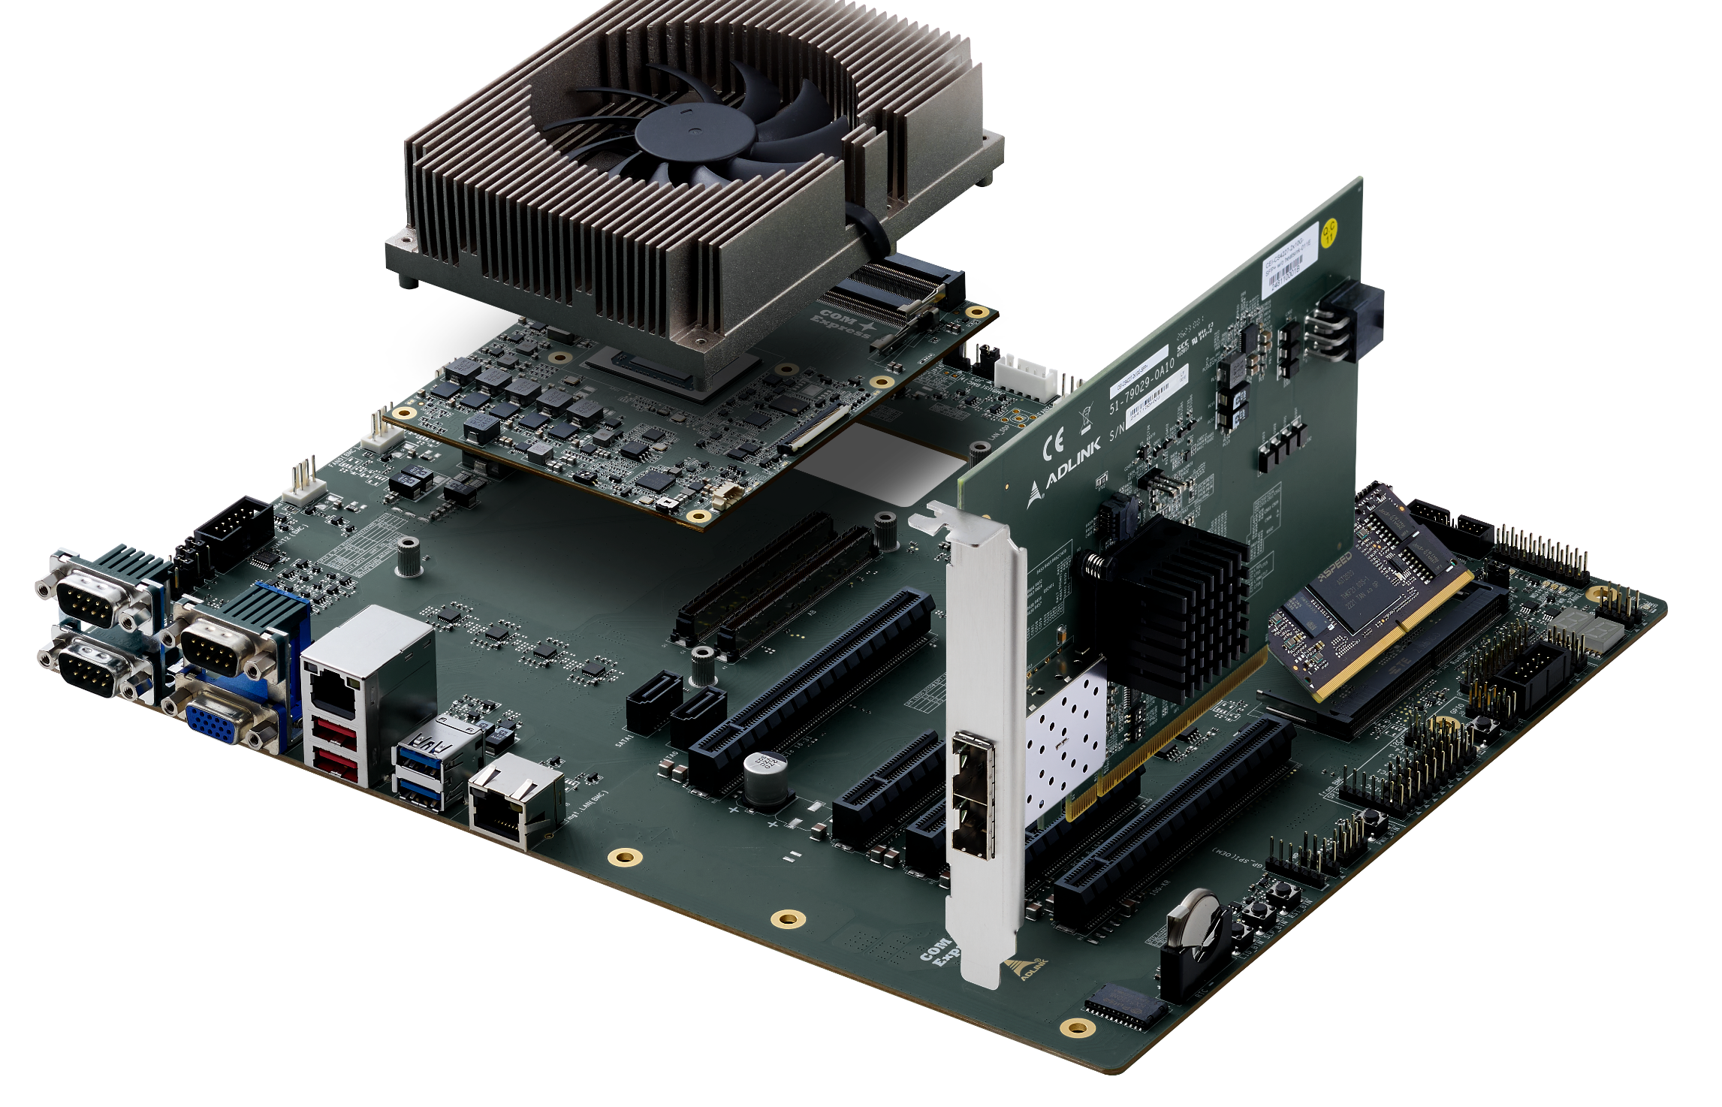
Specific slot (10G-KR)
Dedicated for 10G Ethernet Card

Slide 2
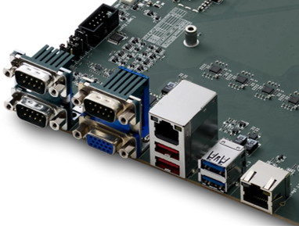
UART2
COM0 (top, SER0)
COM1 (bottom, SER1)
UART1 (top)

Slide 3
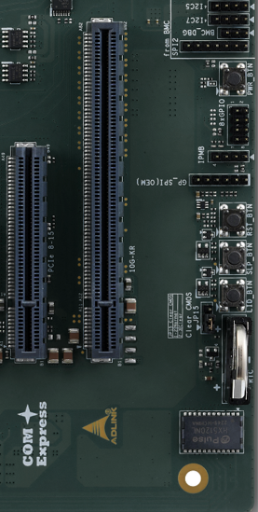
LID_BTN
SLP_BTN
RST_BTN
PWR_BTN

Slide 4
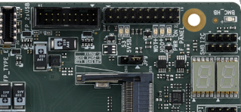
S3 5VSB WDT+ HDD+ PWR_ON
BMC_LED
PORT 80

Slide 5
